Slide 1
Role of OBOT Nurse Care Manager in Federally Qualified Community Health Centers
Colleen T LaBelle, BSN, RN-BC, CARN
AMERSA

Slide 2
Colleen T. LaBelle, Disclosures
Colleen T LaBelle, BSN, RN-BC, CARN has no financial relationships with an ACCME defined commercial interest.
The contents of this activity may include discussion of off label or investigative drug uses. The faculty is aware that is their responsibility to disclose this information.

Slide 3
Planning Committee, Disclosures
AAAP aims to provide educational information that is balanced, independent, objective and free of bias and based on evidence. In order to resolve any identified Conflicts of Interest, disclosure information from all planners, faculty and anyone in the position to control content is provided during the planning process to ensure resolution of any identified conflicts. This disclosure information is listed below:
  The following developers and planning committee members have reported that they have no commercial relationships relevant to the content of this module to disclose: PCSSMAT lead contributors Maria Sullivan, MD, PhD, Adam Bisaga, MD; AAAP CME/CPD Committee Members Dean Krahn, MD, Kevin Sevarino, MD, PhD, Tim Fong, MD, Robert Milin, MD, Tom Kosten, MD, Joji Suzuki, MD; AMERSA staff and faculty Colleen LaBelle, BSN, RN-BC, CARN, Doreen Baeder and AAAP Staff Kathryn Cates-Wessel, Miriam Giles and Blair Dutra.
  Frances Levin, MD is a consultant for GW Pharmaceuticals and receives study medication from US Worldmed. This planning committee for this activity has determined that Dr. Levin’s disclosure information poses no bias or conflict to this presentation.
All faculty have been advised that any recommendations involving clinical medicine must be based on evidence that is accepted within the profession of medicine as adequate justification for their indications and contraindications in the care of patients. All scientific research referred to, reported, or used in the presentation must conform to the generally accepted standards of experimental design, data collection, and analysis. Speakers must inform the learners if their presentation will include discussion of unlabeled/investigational use of commercial products.

Slide 4
Accreditation Statement
This activity has been planned and implemented in accordance with the accreditation requirements and policies of the Accreditation Council for Continuing Medical Education (ACCME) through the joint sponsorship of American Academy of Addiction Psychiatry (AAAP) and Association for Medical Education and Research in Substance Abuse (AMERSA). American Academy of Addiction Psychiatry is accredited by the Accreditation Council for Continuing Medical Education to provide continuing medical education for physicians.

Slide 5
Designation Statement
American Academy of Addiction Psychiatry designates this enduring material for a maximum of 1 (one) AMA PRA Category 1 Credit™. Physicians should only claim credit commensurate with the extent of their participation in the activity.
  Date of Release October 21, 2014
  Date of Expiration October 21, 2014

Slide 6
System Requirements
In order to complete this online module you will need Adobe Reader. To install for free click the link below:
  http://get.adobe.com/reader/

Slide 7
Target Audience
The overarching goal of PCSS-MAT is to make available the most effective medication-assisted treatments to serve patients in a variety of settings, including primary care, psychiatric care, and pain management settings.

Slide 8
Educational Objectives
At the conclusion of this activity participants should be able to:
  List barriers reported by physicians to prescribing buprenorphine in an office based setting
  Describe a collaborative care model for OBOT expansion
  Identify the benefits of FQHC model to expand OBOT
  List functions of the NCM in an OBOT setting

Slide 9
Drug Addiction Treatment Act (DATA) 2000
A New Law
Amendment to the Controlled Substances Act
Allows physician to prescribe narcotic drugs scheduled III, IV or V, FDA approved for opioid maintenance or detoxification treatment
  Prior 10/2002 no drug existed
  Methadone does not qualify Schedule II

Slide 10
DATA 2000:
Physician Qualifications
Physicians must:
Be licensed to practice by his/her state
Have the capacity to refer patients for psychosocial treatment
Limit number of patients receiving buprenorphine to 30 patients for a least the first year
File for a new waiver after first year to increase their limit to 100 patients.
Be qualified to provide buprenorphine and receive a license waiver
Notes:
10

Slide 11
BUPRENORPHINE

Slide 12
Opioid Potency
100
90
80
70
60
50
40
30
20
10
0
Full Agonist
Methadone
%
Efficacy
Partial Agonist
Buprenorphine
Opioid effect, sedation, respiratory depression
Full Antagonist
Naltrexone
-10 -9 -8 -7 -6 -5 -4
Log Dose of Opioid
Dr Laura McNicholas

Slide 13
How Does Buprenorphine Work?
“Ceiling effect” on opioid effects
High affinity for opioid receptor
Slow dissociation from opioid receptor
Formulated with naloxone
  Naloxone blocks opiate effect if injected
  Naloxone is degraded (inert) if taking orally
Notes:
13

Slide 14
Goals of Pharmacotherapy with Buprenorphine:
Prevention or reduction of withdrawal symptoms
Prevention or reduction of drug craving
Prevention of relapse to use of addictive drug
Restoration to or toward normalcy of any physiological function disrupted by drug abuse

Slide 15
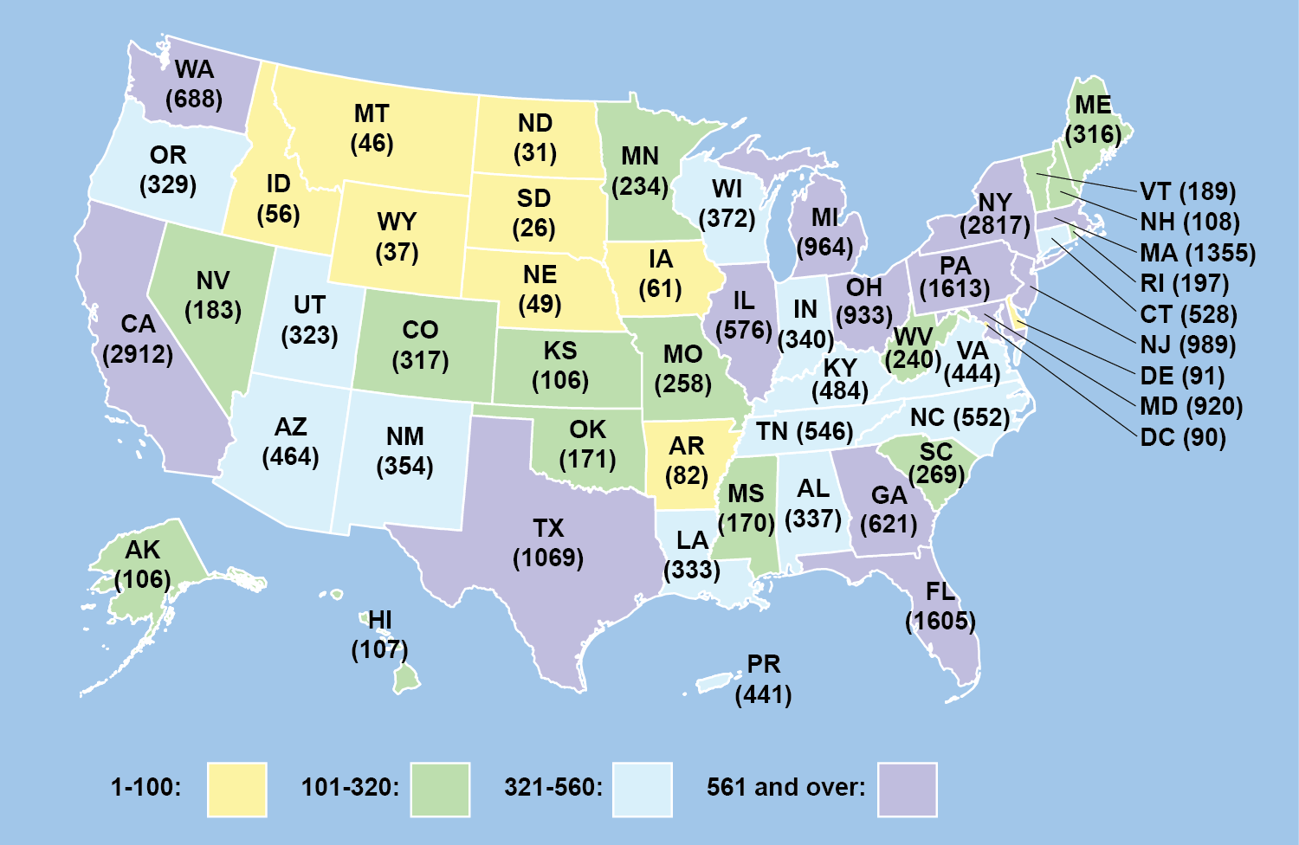
Only 4% of Eligible US Doctors are Certified to Prescribe Buprenorphine
May 2014
Center For Substance Abuse Treatment CSAT 2014

Slide 16
Needs Assessment in MA with Bureau of Substance Abuse Services
High rate of opioid addiction
High number of fatal and non-fatal opioid overdoses
Long waits for opioid treatment, both methadone and buprenorphine
Some people refuse Methadone maintenance
Not enough MA physicians had waivers
Some waivered physicians were not prescribing
MA Department of Public Health Bureau of
Substance Abuse Services 2007

Slide 17
October/November 2005
MDPH sent survey to all 356
waivered physicians
Surveys mailed to 356 addresses
20 not at address
80 non-respondents
256 respondents
21 excluded
No office-based practice
235 included
156 (66%) prescribers
79 (34%) non-prescribers
Walley AY et al. J Gen Intern Med 2008; 23(9): 1393-8

Slide 18
Barriers to Prescribing Office Based Treatment with Buprenorphine

Slide 19
Prescriber Status
and Specialty (n=235)
 | Total | Prescriber N=156 | Non-prescriber N=79
Total | 235 (100) | 156 (66) | 79 (34)
Psychiatrist | 126 (54) | 74 (47) | 52 (67)
Primary Care | 102 (44) | 78 (50) | 24 (31)
Other | 6 (3) | 4 (3) | 2 (3)
Walley AY et al. J Gen Intern Med 2008; 23(9): 1393-8

Slide 20
Barriers to Buprenorphine Prescribing
Insufficient nursing support | 20 %
Insufficient office support | 19 %
Payment issues | 17 %
Lack of institutional support | 16 %
Insufficient staff knowledge | 12 %
Pharmacy issues | 8 %
Low demand | 7 %
Office staff stigma | 5 %
Insufficient physician knowledge | 3 %
One or more barriers | 55%
Walley AY et al J Gen Intern Med 2008; 23(9): 1393-8

Slide 21
Non-prescribers
If barriers improved:
54% (33/61) of those who had never prescribed buprenorphine, will prescribe
67% (10/15) of those who had prescribed, will prescribe
Walley AY et al J Gen Intern Med 2008; 23(9): 1393-8

Slide 22


Only physicians can prescribe.
However, it takes a Multidisciplinary Team Approach for effective addiction treatment.

Slide 23
Boston Medical Center Collaborative
Care Model in General Internal Medicine
5/2003
  1 patient, 1 physician and 1 RN
7/2010
  425 patients (3-6 admissions per week)
  9 physicians
    1 medical director
    3 ABAM certified
    Part-time clinical practices – mean 3 half day sessions/week (range 1-6 sessions)
  3 RNs (3 FTE)
  1 medical asst (1 FTE)
  1 program coordinator (1 FTE)
  1 program director (.4 FTE)
Alford DP et al. Arch Intern Med. 2011

Slide 24
BMC Collaborative Care Model
Program Coordinator intake call
  Screens the patient over the telephone
  OBOT Team reviews the case for appropriateness
NCM and physician assessments
  Nurse does initial intake visit and collects data
  Physician: PE, and assesses appropriateness, DSM IV criteria of opioid dependence
NCM supervised induction (on-site) and managed stabilization (on- and off-site (by phone))
  Follows protocol with patient self administering medication per prescription
Alford DP et al. Arch Intern Med. 2011

Slide 25
BMC Collaborative Care
Nurse Care Managers (NCM)
Registered nurses, completed 1 day buprenorphine training
Performed patient education and clinical care by following treatment protocols (e.g., UDT, pill counts, periop mgnt)
Ensured compliance with federal laws
Coordinated care with OBOT physicians
Collaborated care with pharmacists (refills management) and off-site counseling services
Drop-in hours for urgent care issues
Managed all insurance issues (e.g., prior authorizations)
On average each NCM saw 75 patients/wk
Alford DP et al. Arch Intern Med. 2011

Slide 26
BMC Collaborative Care
Maintenance treatment patient in care (at least 6 months)
  NCM visits weekly for 4-6 wks, then q2 wks, then q1-3 months and as needed.
  Patients seen less than monthly had up to 6 random callbacks/yr
  OBOT physician visits at least every 6 months
Medically supervised withdrawal considered after 6 months of stability if the patient requested to taper, paced with patient needs and stopped if patient requested
Transferred to Methadone if continued illicit opioid use or need for more structured care
Discharged if continued non-adherence or disruptive behavior
Alford DP et al. Arch Intern Med. 2011

Slide 27
BMC Collaborative Care
Preadmission Factors Associated with
Treatment Success
Characteristic | OR (95% CI)
Older age | 1.40 (1.09-1.80)
Employed | 2.24 (1.33-3.77)
Illicit buprenorphine use | 3.04 (1.32-7.00)
African American | 0.50 (0.26-0.99)
Hispanic/Latino | 0.45 (0.22-0.93)
Alford DP et al. Arch Intern Med. 2011

Slide 28
BMC Collaborative Care
Urine Drug Tests
Month | 3 | 6 | 9 | 12
Illicit Opioid NEG | 95% | 94% | 93% | 95%
Cocaine NEG | 95% | 96% | 95% | 98%
Alford DP et al. Arch Intern Med. 2011

Slide 29
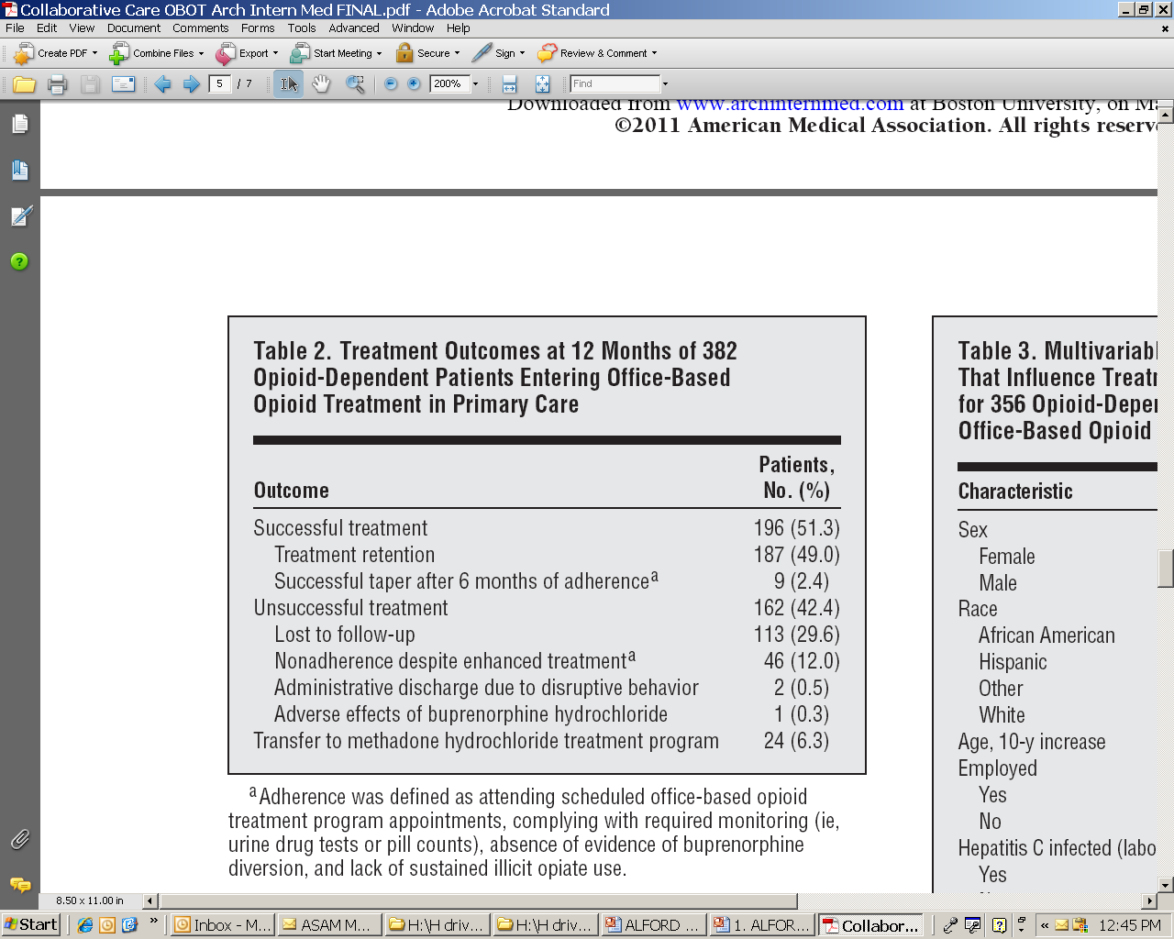
Alford DP et al. Arch Intern Med. 2011

Slide 30
BMC Collaborative Care Model
Conclusions
Patient-level outcomes comparable to physician-centered approaches
Allows efficient use of physician time to focus on patient management (e.g., dose adjustments, maintenance vs taper)
  Allowed physicians to managed > numbers of patients due to support of NCM
Improved access to OBOT and daily management of complex psychosocial needs (e.g., housing, employment, health insurance)
Open communication between NCM and addiction counselors improved compliance
Alford DP et al. Arch Intern Med. 2011

Slide 31
MA STATE OBOT B: Nurse Care Manager Model in FQHCs

Slide 32
State Initiative Project Goals in Federally Qualified Health Centers FQHCs
Treatment expansion and access to buprenorphine
Create a model for the effective delivery of buprenorphine services:
  Modeled after BMCs Nurse care manager program
Integrate addiction treatment into primary care settings
Increase the number of MD’s with waivers
Increase the number of individuals treated for opioid addiction
Focus on high risk areas, homeless individuals and pregnant women, Latino, African American
Collect and analysis data
Sustainability of project after funding ends
MA Department of Public Health Bureau of
Substance Abuse Services 2007

Slide 33
MA Department of Public Health Bureau of Substance Abuse Services Released two RFR’s: In Response to Unmet Need
  Funding for a Nurse Care Manager Model in all Community Health Centers (CHC) in the state who submitted responses to RFR
  Required CHC to partner with addictions counseling service providers
  Funding for training and technical assistance to the CHC OBOT’s and to all nonprofit providers interested in providing OBOT or needing support/consult
  Funding awarded for 3 years with an 8/07 start date, renewable for a total of 7 years and has since been extended using Block grant and state funds
  Modeled after Boston Medical Centers Nurse Care Manager Model
MA Department of Public Health Bureau of
Substance Abuse Services 2007

Slide 34
RFR Funding
$270,000 per year for Technical Assistance: training, booster sessions, quarterly state educational sessions, conference calls, site visits, support staff and admin assistance, support to statewide providers in nonprofits, accountability of grant deliverables.
$100,000 per CHC for Nurse Care Manager
  1 full time RN
  1:100 staff to patient ratio
    Rolling admission of new patients each week to reach the 100
  1:125 with addition of Medical Assistant in year 4 of the grant, and less funding to support NCM
Funding allowed billing for
  Nurse Care Manager Salary initially
    In year 4, 25% to nurse salary the remainder to MA as the NCM is reimbursable, the MA allows for additional patients and transfer of non nursing tasks to MA
  Fringe
  Transportation
  Supplies
MA Department of Public Health Bureau of
Substance Abuse Services 2007

Slide 35
TA Support
Nursing training and ongoing support
  Phone, email, site visits, chart reviews
  Quarterly statewide NCM meetings:
    addiction education, support, networking
Site support:
  Education all providers
    Trainings: addiction, buprenorphine, stigma, management, set up
  Support practice: MD and nursing issues
  Care for or triage patients to other sites due to closures, staff changes, emergency issues
  DEA Support: Education and preparation, support at visits
  Waiver assistance, insurance support, coverage, carrier issues
MA Department of Public Health Bureau of
Substance Abuse Services 2007

Slide 36
What is a Federally Qualified Community Health Centers (FQHCs)
In 1965, federal government created a demonstration project funding CHC’s
  Current model was established in 1975
  1996 funding streams merged to create health center grant program under Section 330 of the Public Health Act
  Health Resources and Service Administration (HRSA) distributes grant funding to FQHC’s
FQHC’s are nonprofit organizations delivering Team based integrated care with physicians, advanced practice nurses, physicians assistants, nurses and other non-physician practitioners.
Tasked with caring for medically underserved patients in underserved areas
Health Resources and Services Administration HRSA

Slide 37
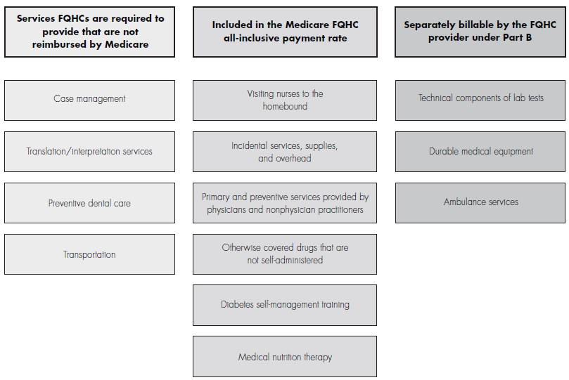
Benefits Provided at FQHCs
CSM Medicare benefit policy manual, 2009

Slide 38
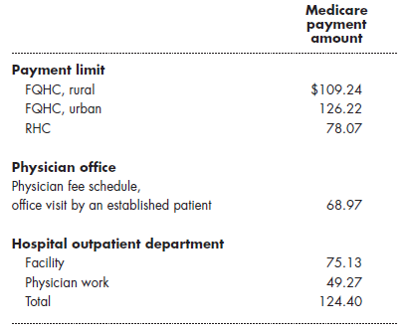
Comparing Medicare’s FQHC and RHC payment to physician office visit and hospital outpatient visit, 2011
*Level 3 Visit
Note: FQHC, RHC, the physician fee schedule and outpatient department (OPD) figures are the national payment amount. Healthcare Procedure Coding System code 99213 for the physician fee schedule and OPD payment amounts. Medicare’s payment rate for a physician office visit includes the practice expense (i.e facility-level) payment.
2011 physician fee schedule, Hospital Outpatient Prospective Payment System

Slide 39
Public Health Service Act (defines FCHC)
Benefits Improvement and Protection Act 2000
Establishes payment requirements for Medicaid
Federally mandates paying FCHC’s “average reasonable costs” to service medically under-served populations
Gives each state the authority and flexibility to define services, providers, and rates
Section 330(a) of the PHS Act
Health centers requesting funding to serve homeless individuals and their families must provide substance abuse services among their required services. (Section 330(h)(2) of the PHS Act)
Health Resources and Services Administration HRSA

Slide 40
Cost Modeling in FQHCs in MA Concluded:
MA Department of Public Health Bureau of
Substance Abuse Services 2010 Cost modeling report by Paul Cote
Allows RN’s to bill for an “Individual Medical Visit”
Rate is the same as for an MD visit
Assuming a nurse to patient ratio of 1:100
  90% utilization for a mixed frequency caseload
  Included overhead and administrative costs
  Federally QHC would make a profit of approximately $180,000 per fulltime NCM
  NCM providing OBOT is sustainable and viable in a Federally Qualified Community Health Center

Slide 41
UMass Study Findings in Massachusetts
Studied 5,600 Mass Health Clients prescribed buprenorphine and methadone
Overall Mass Health expenditures lower than for those with no treatment
Clients on Medication Assisted Treatment (MAT) had significantly lower rates of relapse, hospitalizations and ED visits: no more costly than other treatments
Buprenorphine attracting younger and newer clients to treatment
R.E. Clark; Health Affairs, August 2011

Slide 42
Nurse Care Manager Model
Screener by coordinator or nurse
RN intake: labs, UTS, contracts, education
Counselor - intake, refer to psych if warranted
Intake reviewed by the OBOT team (RN, MD)
Bupe MD visit: review, assess, clear for treatment appropriateness with DSM IV Dx Opioid Dependence
Induction: stabilization, maintenance
  Management by RN with waivered prescriber
    Visits, assessments, education, UDS, labs, MD contacts
    Facilitate prescription refills, medical monitoring, relapse, surgery, pregnancy, mental health needs, social supports, treatment plans

Slide 43
OBOT RN
Nursing Assessment:
Intake assessment
  Review medical hx, treatment hx, pain issues, mental health, current use, and medications
Consents/Treatment agreements
  Program expectations: visits & frequency, UDS, behavior
  Understanding of medication: opioid, potential for withdrawal
  Review, sign, copies to patient and review at later date
Education
  On the medication (opioid), administration, storage, safety, responsibilities and treatment plan
Urine toxicology screen
  Screen drug of use and ? Others: If positive what that may mean for treatment
LFT’s, Hepatitis serologies, RPR, CBC, pregnancy test

Slide 44
OBOT MD
Review of history
  Mental health, substance use, medical, social
Physical Exam
Lab and urine review
  Assess contraindications, toxicology
Confirm Opioid Dependence diagnosis
  DSM IV criteria
Confirm appropriate for office treatment
Writes the orders and prescription
Develop Treatment Plan with OBOT Team

Slide 45
OBOT RN Role In FQHC’s
Review and support program requirements:
  Nurse/ Physician Appointments:
    Frequency, times, location
  Counseling:
    Weekly initially, self help, mental health as needed
  Obtain urine toxicology:
    At visits, call backs, as needed and follow up
  Support abstinence/ harm reduction
    Abstinence from opioids is the goal
    Safety with the goal to minimize substance use
  Educate and monitor for Safety:
    Medication storage, management, adherence
    Relapses, assess risk benefit

Slide 46
OBOT RN
Follow up Visits:
Assess dose, frequency, cravings, withdrawal
Ongoing education: dosing, side effects, interactions, support.
Counseling, self help check in
Psychiatric evaluation and follow up as needed
Medical issues: vaccines, follow up, treatment HIV, HCV…Engage in care
Assist with preparing prescriptions
Facilitating prior approvals and pharmacy
Pregnancy: if pregnant engage in appropriate care
Social supports: housing, job, family, friends

Slide 47
NCM Model in FQHC Allows:
Greater numbers of patients able to access treatment
Supports complex patient needs without burdening providers
Allows patients to access treatment in their community
Integrated within primary care therefore supports primary care needs: HTN, HCV, HIV, DM, etc.
Integrates addictions care into medical treatment
Individualizes treatment
Removes Stigma
Engages providers
Is financially sustainable

Slide 48
STATE OBOT B MD’s Waivered in Community Health Centers:

Slide 49
Hospital Admissions
2008: N=296
2009: N=595
2010: N=582
2011: N=458
Notes:
Hospital data is only available through 9/30/2012
Enrollments must have lasted at least 12 months
Paid amounts are calculated using hospital specific pay to charge ratios

Slide 50
ER Visits
2008: N=296
2009: N=595
2010: N=582
2011: N=458
Notes:
Hospital data is only available through 9/30/2012
Enrollments must have lasted at least 12 months
Paid amounts are calculated using hospital specific pay to charge ratios

Slide 51
ER Expenditures
Notes:
Hospital data is only available through 9/30/2012.
Enrollments must have lasted at least 12 months
Paid amounts are calculated using hospital specific pay to charge ratios

Slide 52
STATE OBOT B Physicians waivered in CHC’s pre and post grant :
Providers waivered to prescribe buprenorphine pre and post NCM model in funded CHC’s in MA

Slide 53
STATE OBOT B Patients receiving buprenorphine in CHC’s:
Patients treated with buprenorphine pre and post NCM model in funded CHC’s in MA

Slide 54
Challenges for Addiction Nurses in FQHC’s
Many with limited to no addiction experience
  Require initial training; booster sessions, educational opportunities
  Ongoing support, training, mentoring
    Need access to addiction providers: cell phone, email, meetings, site visits
Difficult to hire experienced addiction nurses into health center
  Salary
  Environment: isolated, limited addiction colleagues
  Support network: doing this alone within center
  Many doctors turn to RN: have waiver limited experience

Slide 55
Challenges in FQHC’s
Waivered Physicians:
Physicians with limited addiction experience or support
  Mentors, resources are key
Limited waivered providers
  Back up support: vacation, moves, leaves
  Try to engage and enlist other providers
Physician leaves practice
  Need to train and enlist other MD’s
  Back up of waivered providers
  Providers at cap: State support network allows for transfer to other practice
Health center has minimal buy in
  May not require providers to be waivered, limiting numbers of providers

Slide 56
Next Steps
Utilizing nurse care manager models to expand treatment to more sites
Increase level of education among providers in addiction treatment
  Nurses, doctors, support staff, and administration
Require all physicians to obtain and X number
Integrate in to the medical home model of care
Look at drop out rates and reasons: improve retention
Follow treatment and prevention outcomes when patients are in care for addiction

Slide 57
References
Alford DP, LaBelle CT, Kretsch N, Pierson A, Botticelli M, Winter M, Samet, JH. Collaborative Care of Opioid Addicted Patients using Buprenorphine in Primary Care: Five Year Experience. Archives of Internal Medicine 2011;171(5) 425-431
Alford DP, Salsitz E, Martin J, Renner JA. Clinical case discussion: Treating opioid dependence with buprenorphine. J Addict Med. 2007;1:73-78Alford DP, LaBelle CT, Richardson JM, O’Connell JJ, Hohl CA, Cheng DM, Samet JH. Treating homeless opioid dependent patients with buprenorphine in an office-based setting. Journal of General Internal Medicine, January 2007.
Center for Medicare & Medicaid Services, Department of Health and Human Services, 2009. Chapter 12: Rural health clinic and federally qualified health center services. Medicare benefit policy manual. Baltimore, MD: CMS.
Center for Medicare & Medicaid Services, Department of Health and Human Services, 2011d. Rural health clinics and federally qualified health centers billing guide. MLN Matters no. SE1039.
Center for Substance Abuse Treatment. Medication-Assisted Treatment for Opioid Addiction in Opioid Treatment Programs. Rockville (MD): Substance Abuse and Mental Health Services Administration (US); 2005. (Treatment Improvement Protocol (TIP) Series, No. 43.) Available from: http://www.ncbi.nlm.nih.gov/books/NBK64164/

Slide 58
References
Center for Substance Abuse Treatment. Clinical Guidelines for the Use of Buprenorphine in the Treatment of Opioid Addiction, Treatment Improvement Protocol (TIP) Series 40. DHHS Publication No. (SMA) 04- 3939. Rockville, MD: Substance Abuse and Mental Health Services Administration; 2004.
Center for Substance Abuse Treatment. Clinical Guideline for Buprenorphine: A Guide for Nurses, TAP 30, Technical Assistance Publication Series http://buprenorphine.samhsa.gov/TAP 30. DHHS Publication. Rockville, MD: Substance Abuse and Mental Health Services Administration; 2009.
Clark, R.E., Samnaliev, M., Baxter, J.D., & Leung, G.Y., (2011). The Evidence Doesn’t Justify Steps By State Medicaid Programs to Restrict Opioid Addiction Treatment with Buprenorphine. 30(8), 1425-1433.
Fiellin DA, Rosenheck RA,Kosten TR. Office-based treatment for opioid dependence: reaching new patient populations. Am J Psychiatry.2001;158(8):1200–4.8
Fiellin DA, O'Connor PG. Clinical practice. Office-based treatment of opioid-dependent patients. N Engl J Med. Sep 12 2002;347(11):817-823.

Slide 59
References
Health Services and Resource Administration: Section 330 of the Public Health Service Act http://bphc.hrsa.gov/policiesregulations/legislation/index.html (42 USCS § 254b) Authorizing Legislation of the Health Center Program.
Kuehn BM. Office-based treatment for opioid addiction achieving goals. JAMA. 2005;294(7):784– 6.11 National Conference of State Legislatures. 50-state table: Medicaid. financing of medication-assisted treatment for opiate addiction [Internet]. Washington (DC): NCSL; 2008 Apr 1 [cited 2009 Sep 10]. Available from: http://www.ncsl.org/default.aspx?tabid= 14144#32
Massachusetts Department of Public Health Bureau of Substance Abuse Services Office Based Opioid Treatment RFR, 2007
Massachusetts Department of Public Health Bureau of Substance Abuse Services, Cost modeling analysis by Paul Cote on FQHC sustainability and billing OBOT in CHCs, 2010.
Saitz, R, Larson J, LaBelle C, Richardson J, Samet JH. The Case of Chronic Disease Management for Addiction. Journal of Addiction Medicine, 2008.
Walley AY, Alperen J, Cheng DM, Botticelli M, Castro-Donlan C, Samet JH, Alford, DP. Office-based management of opioid dependence with buprenorphine: treatment practices and barriers. J Gen Intern Med 2008; 23(9):1393-8

Slide 60
PCSS-MAT Mentoring Program
PCSS-MAT Mentor Program is designed to offer general information to clinicians about evidence-based clinical practices in prescribing medications for opioid addiction.
PCSS-MAT Mentors comprise a national network of trained providers with expertise in medication-assisted treatment, addictions and clinical education.
Our 3-tiered mentoring approach allows every mentor/mentee relationship to be unique and catered to the specific needs of both parties.
The mentoring program is available, at no cost to providers.
For more information on requesting or becoming a mentor visit:
pcssmat.org/mentoring

Slide 61

PCSSMAT is a collaborative effort led by American Academy of Addiction Psychiatry (AAAP) in partnership with: American Osteopathic Academy of Addiction Medicine (AOAAM), American Psychiatric Association (APA) and American Society of Addiction Medicine (ASAM).
For More Information: www.pcssmat.org
Twitter: @PCSSProjects
Funding for this initiative was made possible (in part) by Providers’ Clinical Support System for Medication Assisted Treatment (5U79TI024697) from SAMHSA. The views expressed in written conference materials or publications and by speakers and moderators do not necessarily reflect the official policies of the Department of Health and Human Services; nor does mention of trade names, commercial practices, or organizations imply endorsement by the U.S. Government.

Slide 62
Please Click the Link Below to Access the Post Test for this Online Module
  Click here to take the Module Post Test
Upon completion of the Post Test:
If you pass the Post Test with a grade of 80% or higher, you will be instructed to click a link which will bring you to the Online Module Evaluation Survey. Upon completion of the Online Module Evaluation Survey, you will receive a CME Credit Certificate or Certificate of Completion via email.
If you received a grade of 79% or lower on the Post Test, you will be instructed to review the Online Module once more and retake the Post Test. You will then be instructed to click a link which will bring you to the Online Module Evaluation Survey. Upon completion of the Online Module Evaluation Survey, you will receive a CME Credit Certificate or Certificate of Completion via email.
After successfully passing, you will receive an email detailing correct answers, explanations and references for each question of the Post Test.

